Slide 1

MSCA 31012 Data Engineering Final Project
Global Agriculture Analytics
Group 4
Team Member
Boni Oloff Nugraha
Harry S Hendharto
Johnson Bam

Slide 2
Agenda
1. | Executive summary | 3
2. | Objective & Data Source | 4
3. | Tools | 5
4. | Methodology | 6
5. | Logical Data Model | 7
6. | EER Diagram | 8
7. | Analysis | 9
8. | Visualization | 14
9. | Modelling | 16
10. | Recommendations | 17

Slide 3
In the modern economy, there are many complex factors shaping the underlying supply and demand of agricultural commodity.
For both business and policy maker, it is critical to understand the dynamics of commodity supply (production, import) and demand (consumption, processed, and export) to stay competitive.
This project aims to provide users with an accurate global agriculture analytics from 103 agricultural commodities across 189 countries along 15 years horizon.
By combining production, tariff, trade, and socio-economic data, this project tries to offer a rich insights to discover an opportunity for an expansion: new purchases or supply sources of a certain commodity from emerging supplier/buyer.
Executive Summary

Slide 4
Data Sources
Objectives
Agriculture
Food & Agriculture Org. (FAO)
Production
Utilization or usage
Climate
Identify the leading (also emerging) global producers and consumers
Find opportunities to buy commodity from emerging producer with low tariff and competitive trade facilitation (e.g. efficient logistics)
Analyze the country-commodity specific characteristics (e.g. productivity, climate related trend)
Trade
World Trade Org. (WTO)
Export-Import
General Trade Tariff
Other Duties
Global Agriculture Analytics
Socio-Economic
World Bank
Agriculture Employment
Rural VS Urban Population
Income Level
Logistics performance
Data sources: FAO, WTO, and World Bank
http://www.fao.org/faostat/en/#data
http://tariffdata.wto.org/Default.aspx?culture=en-US
https://databank.worldbank.org/source/world-development-indicators

Slide 5








Tools
Extract | Transform | Load | Visualization
Sources: FAO, WTO, World Bank
Use python script to clean the Data
The data extracted from source was stored in a MySQL Database
Use python script to load excel files into MySQL Database
Python and Tableau was used to visualize and explore the dataset

Slide 6
METHODOLOGY
Extract
Transform
Load
Raw Data
Download multiple .csv files from FAO, WTO, and WB databases
Reformat incorrect data type
Ex: From float to integer (for IDs)
EER Design
Forward Engineer
Drop irrelevant columns
Redundant code for commodity
Unused variables (e.g. nutrition indicators)
Redundant group for commodity
Build data dictionary to prepare the join
Commodity ID
FAO Code (Item) – WTO Code (HS)
Country ID
Country Reporter Classification (FAO, WTO, WB) Region Classification
Tariff
Concatenate all agricultural related tariff
Load into MySQL using Python
Filter for agriculture trade data only
Based on the FAO as the baseline
Joins
production_stat: Production ⨝ Commodity Dict ⨝ Country Dict
stock_stat: Stock ⨝ Commodity Dict ⨝ Country Dict
trade_stat: Export ⨝ Import ⨝ Tariff ⨝ Commodity Dict ⨝ Country Dict
country_climate: Climate ⨝ Country Dict
country_stat: Country Dict ⨝ Population ⨝ Employment ⨝ Income ⨝ Logistics

Slide 7
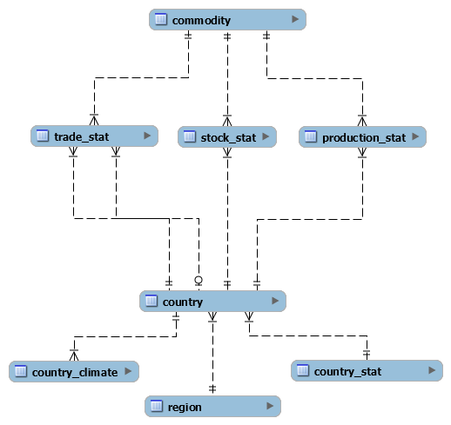

Logical Data Model
Commodity Related Characteristics (Production, Export-Import, Processing, Inventory, etc)
Commodity
Contains the list of commodity name along with their codes, commodity group (e.g. fruit), and description
Trade_stat
Contains the record of trade (export or import) in terms of quantity or value for each country pair (from-to), by year, by country
Stock_stat
Contains the record of downstream processing of commodity (processed, loss, inventory) by commodity, by year, by country
Production_stat
Contains the record of production (production value, yield, area harvested) by commodity, by year, by country
Country
Contains the list of country names alon with their code
Country_climate
Contains the list of temperature deviation from the baseline by year by country
Country_stat
Contains the list of socio-economic data e.g. population, employment, etc for by year by country
Region
Contains the information of region name for each country
Country Related Characteristics (Socio-Economic and Climate)

Slide 8
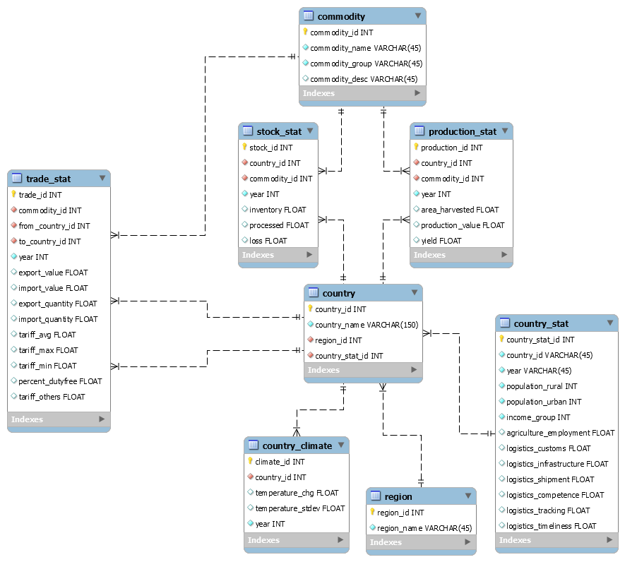



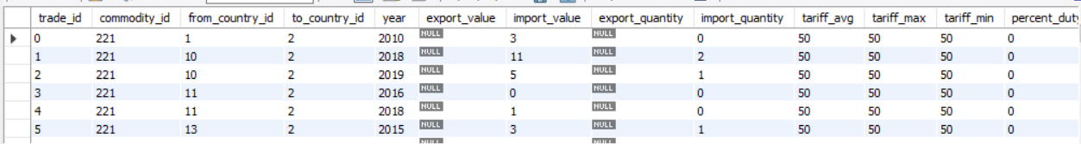
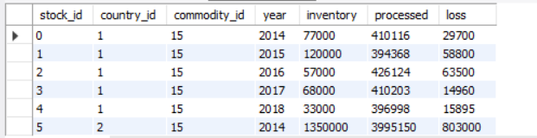
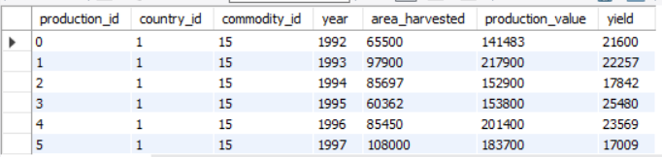
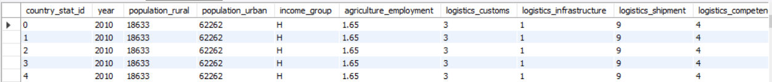
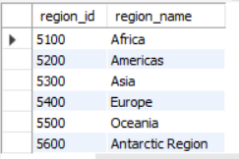
EER Design (Relational)
Sample Record
commodity
country
country climate
trade_stat
Stock_stat
Production_stat
Country_stat
region

Slide 9
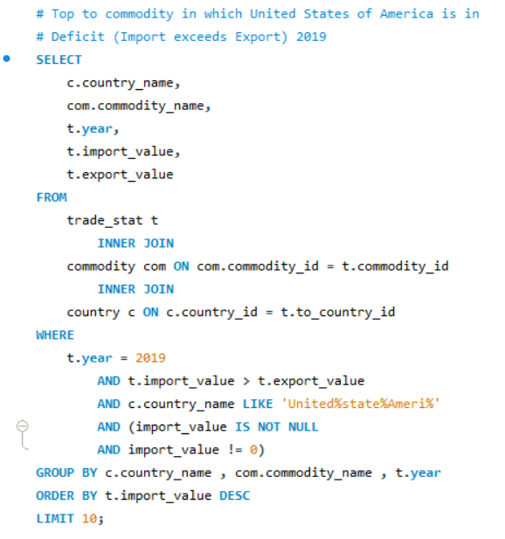
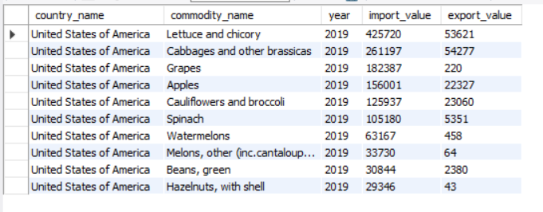
Query 1: Top commodity in which United States of America is in Deficit (Import exceeds Export) 2019

Slide 10
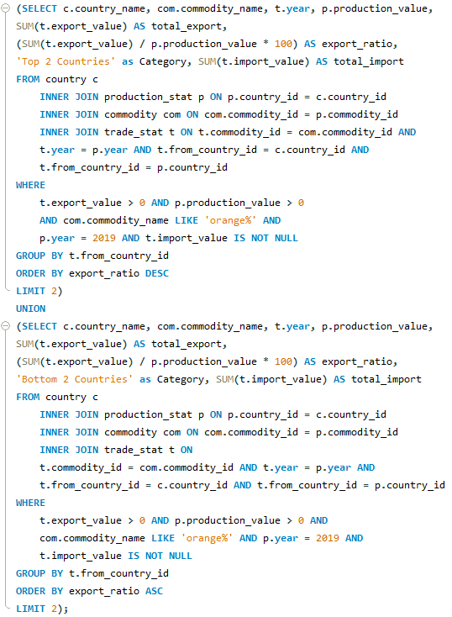

Query 2: Top 2 & Bottom 2 orange exporters relative to their domestic production

Slide 11
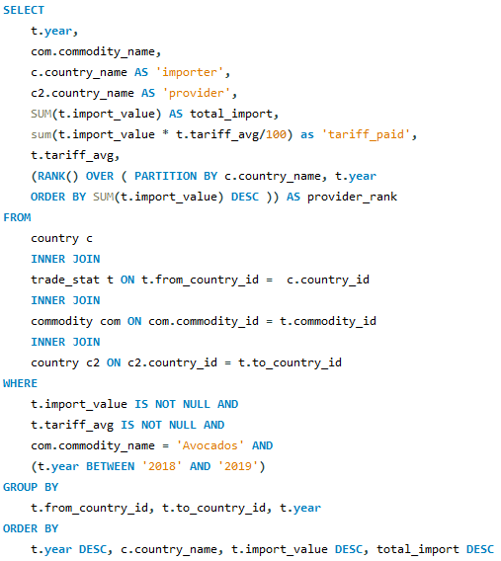
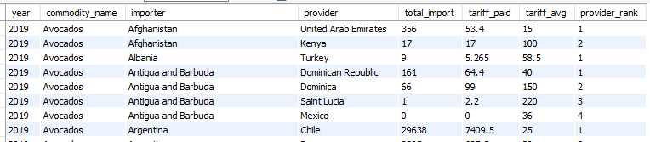
Query 3: For specific commodity (e.g., Avocados), list main provider of that commodity which a country rely on and calculate the total paid tariff ($ Million)

Slide 12
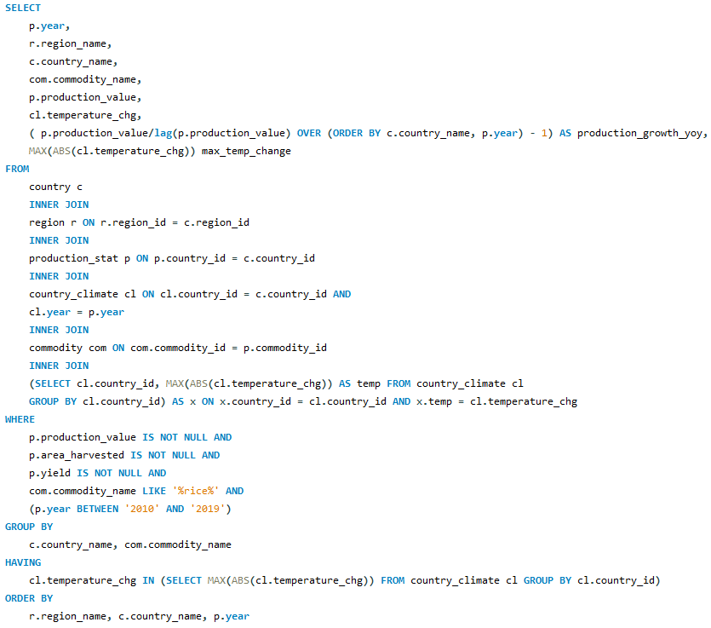
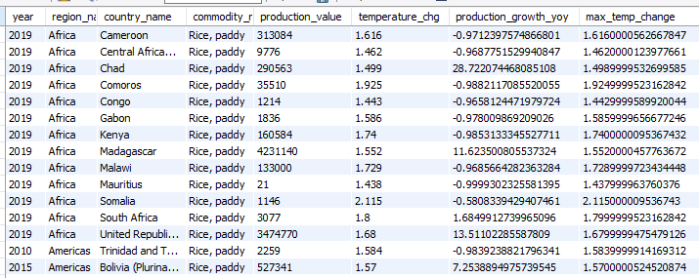
Query 4: Identify the year when extreme temperature change happened and compare it with the production growth (YoY)

Slide 13
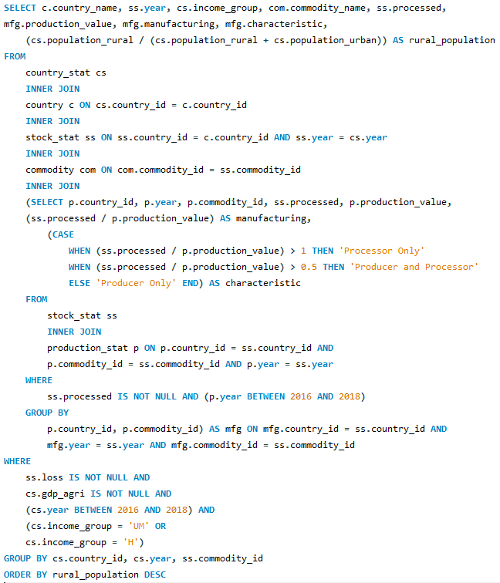
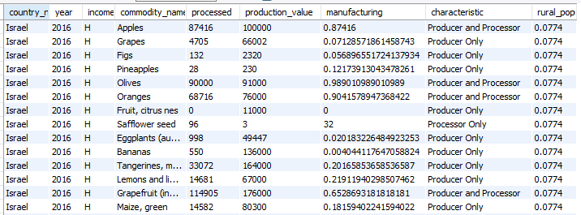
Query 5: Determine whether a high or upper middle-income country is a processor only / producer only / or both, and sort by share of rural population growth (YoY)

Slide 14
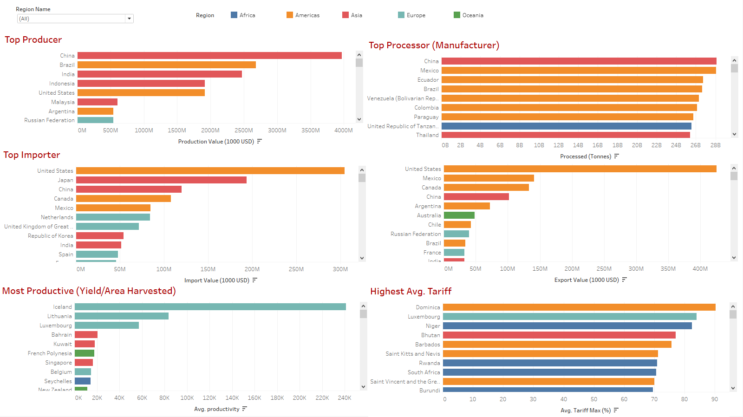
Visualization 1: Top Player in Global Agriculture Markets

Slide 15
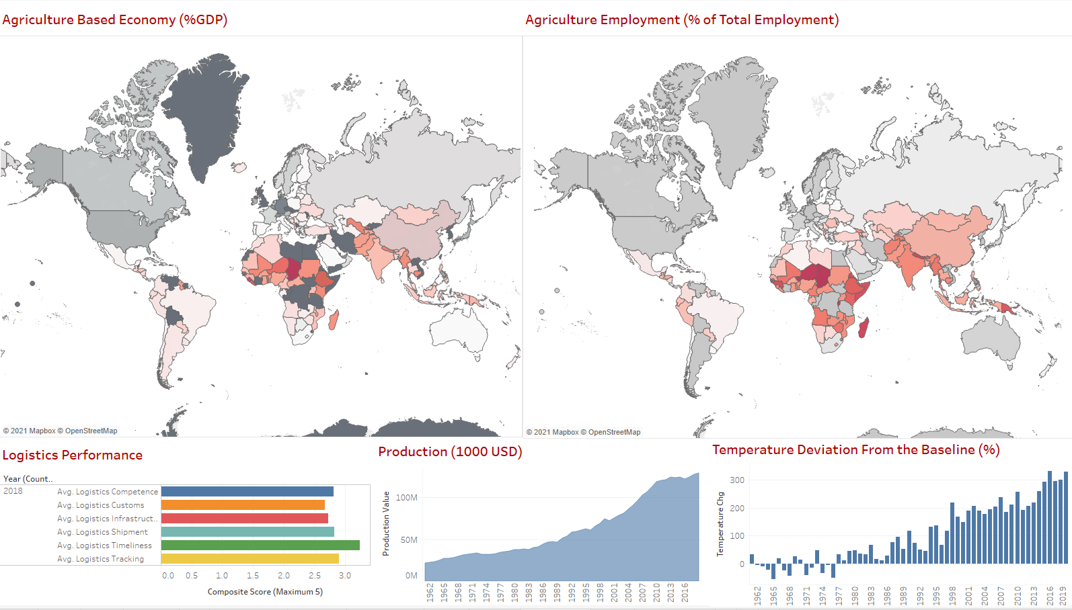
Visualization 2: Agriculture From Socio-Economic Perspectives
Visualization 2

Slide 16
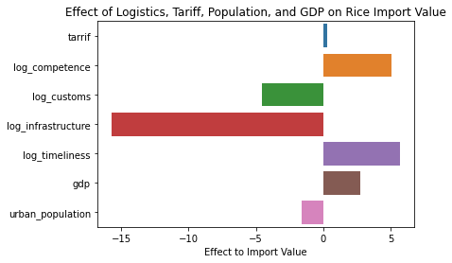
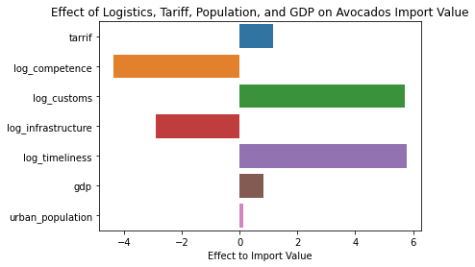
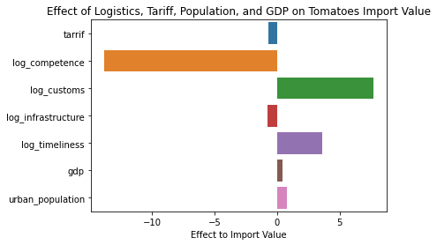
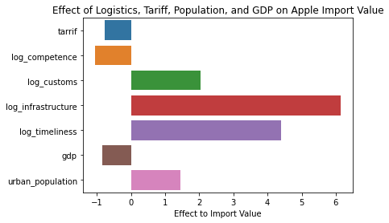
Visualization 2: The Effect of Logistics, Tariff, Population and GDP to Import Values

Slide 17
Recommendations
China is the largest producer and processor (manufacturer) in the world and United States of America is the largest importer. We there recommend that United States of America should have trade agreement with China and negotiate for low tariffs.
Rice importation has positive association with GDP than commodities in the fruit category like Apple. We therefore recommend countries to minimize the importation commodities in the fruit category.
Logistics infrastructure is positively associated with fruit importation. That is higher investment on logistics infrastructure for countries importing more fruits. Our recommendation is for countries to grow their own fruits to save money on both imports and infrastructure.
From the model, smaller country like Iceland has a high productivities (yield/area harvested).
Some countries impost high tariff on their commodity due to factors beyond the scope of this project. Our recommendation is for countries looking for low tariffs should focus on developed countries who in the same production.

Slide 18


